Slide 1
DIGITAL SIGNAL PROCESSING
ECE-2006 : PROJECT REVIEW

Slide 2
Team
Abhas Mathur : 16BEC0010
Sanskar Biswal : 16BEC0403

Slide 3
Project Title
Secure Transmission by Signal Encryption and Encoding

Slide 4
Approach
The input message signal will follow a random scramble pattern for data rearrangement before transmission. On the receiver end, only the accurate key can be used to unscramble data. A double-key encryption method will be used.
This method is termed as RSA cryptography algorithm.

Slide 5
RSA cryptography
RSA involves a public key and private key. The public key can be known to everyone; it is used to encrypt messages. Messages encrypted using the public key can only be decrypted with the private key. The keys for the RSA algorithm are generated the following way:
Two large random prime nos. ‘p’ and ‘q’ are chosen.
n = pq ; n is the modulus of pq
ɸ(n) = (p-1)*(q-1) . Here ɸ(n) is called a totient.
An integer ‘e’ such that ; 1<e< ɸ(n) is chosen. ‘e’ is the public key.
For some integer k, ‘d’ is chosen ; d = (1+k ɸ(n)/e). ‘d’ is the private key

Slide 6
Encrypting messages
To establish communication between point ‘A’ and ‘B’
‘A’ shares pubic keys (n,e) with ‘B’, who wants to send message M to ‘A’.
‘M’ converted into m, m<n by using a reversible protocol, ie: padding scheme.
Ciphertext c = m^{e} mod n is generated on B side
Ciphertext ‘c’ is sent as message to A

Slide 7
Decrypting messages
At A, m can be retrieved by, m = c^{d} mod n. The private key ‘d’ is known by A.
The original prime nos. may be recovered by, c^{ed} = m mod(pq)
The message ‘m’ is reversed by the padding scheme and the message M is retrieved by A

Slide 8
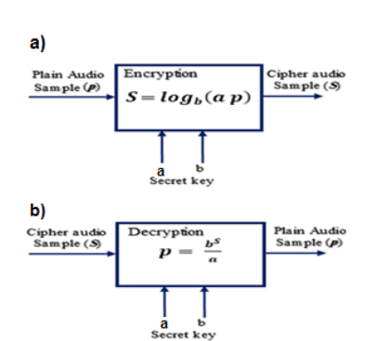
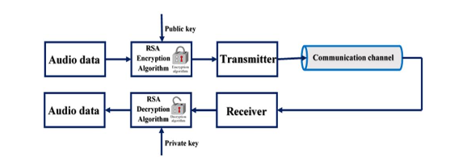
Block diagram

Slide 9
Project objectives
To develop a Simulink model to implement and observe a functional model of a secured communication model.
The system will convert the analog audio data into digital format prior to implementing RSA encryption.

Slide 10
Software and tools
MATLAB 2016Ra
Simulink
Arduino (for data acquisitions and iterations); (Optionally, .wav or .mp4 files may be used directly)

Slide 11
Thank you

